Slide 1
User Experience Study on DASH
Liu Yitong, Liu Hao, Shen Yun, Lin Qi, Shen Hui, Li Yuchen
liuyitong@bupt.edu.cn
Wireless Theories and Technologies Lab
Beijing University of Posts and Telecommunications

Slide 2
Summary
DASH QoE Evaluation
Build BUPT QoE model of DASH service
More accurate than UCSD model
Research impacts of 3 impairment factors on DASH service: Initial Delay, Stall, and Level Variation
Propose an accurate QoE model considering level variation
Based on Primacy and Recency Effects
Identify level variation influence factors: Bitrate Switching, Bitrate Fluctuation Pattern
DASH User Experience Improvement
Study on QoE-based bitrate adaptation algorithm in DASH service
Analyze stall probability and duration
Utilize a real-time QoE model with stall prediction into the bitrate adaptation algorithm
Select bitrate level to maximize QoE
Propose a bandwidth estimating method in DASH service
Consider 2 typical scenarios
Response quickly for long-term variation and keep stable for short-term fluctuation
Research on the performance of bitrate adaptation for multi-user DASH（On-going）

Slide 3


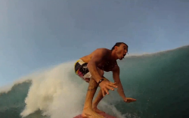
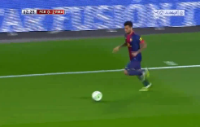
User Experience Impairment Factors on DASH Service
R = f(I_{ID}, I_{ST}, I_{LV})
Impairment due to Initial Delay
Impairment due to Level Variation
Impairment due to Stall
Test videos provided by Qualcomm
Medium motion (Bunny Cartoon, Movie)
High motion (Sports)
Video | Amount | Motion | Test factors
Bunny Cartoon | 11 | Medium | Stall
Movie Case | 48 | Medium | All factors*
Sport Case | 48 | High | All factors
More than 2800 votes are received
Test 107 video samples and 64 participants
Each tester watches about 45 test video clips in one hour.
Each video clip obtains at least 21 votes.
Evaluation methodology: Single-Stimulus (SS)
All factors*: Stall, Initial Delay, and Level Variation
Guidance by Qualcomm Research: Yinian Mao (SD), Sha Hua (SD), and Ruiming Zheng (BJ)

Slide 4
User Experience Impairment Factors on DASH Service
Correlation of impairment factors
Conclusion
Variation | R | I_{ID} | I_{ST} | I_{LV}
R | —
I_{ID} | 0.234 | —
I_{ST} | 0.001 | 0.327 | —
I_{LV} | 0.000 | 0.927 | 0.946 | —
Impairments of Stall and Level Variation is more serious than Initial Delay.(1st row)
Initial Delay is nearly independent with Stall and Level Variation. (2nd and 3rd row)
Initial Delay and Stall Duration follow linear relation with QoE
*Strong correlation when value <0.05
Guidance by Qualcomm Research: Yinian Mao (SD), Sha Hua (SD), and Ruiming Zheng (BJ)

Slide 5
User Experience Impairment Factors on DASH Service
R = f(I_{ID}, I_{ST}, I_{LV})
Impairment due to Initial Delay
Impairment due to Level Variation
Impairment due to Stall
Medium motion
High motion
Video | Amount | Motion | Test factors
Bunny Cartoon | 11 | Medium | Stall
Movie Case | 48 | Medium | All factors*
Sport Case | 48 | High | All factors
More than 2800 votes are received
Test 107 video samples and 64 participants
Evaluation methodology: Single-Stimulus (SS)
All factors*: Stall, Initial Delay, and Level Variation
Conclusion
Impairments of Stall and Level Variation is more serious than Initial Delay.(1st row)
Initial Delay is nearly independent with Stall and Level Variation. (2nd and 3rd row)
Initial Delay and Stall Duration follow linear relation with QoE
Correlation of impairment factors
Variation | R | I_{ID} | I_{ST} | I_{LV}
R | —
I_{ID} | 0.234 | —
I_{ST} | 0.001 | 0.327 | —
I_{LV} | 0.000 | 0.927 | 0.946 | —
*Strong correlation when value <0.05
Guidance by Qualcomm Research: Yinian Mao (SD), Sha Hua (SD), and Ruiming Zheng (BJ)

Slide 6
Propose QoE Model
Conduct subjective test on Qualcomm’s request
Validate the UCSD model with BUPT subjective results
UCSD model is not accurate in BUPT subjective test
Build a new model based on the observation of 3 impairment factors
UCSD Model
BUPT Model
The best formulation out of 15 basic elementary functions
Performance analysis
Performance of BUPT Model
Performance Validation of UCSD Model
PCC : 0.9251 MSE : 0.0536
Performance is improved, even better in low motion scenario.
Result of UCSD Model
(Provided by UCSD)
PCC : 0.91
MSE : 0.082
Our Validation Result of UCSD Model
PCC : 0.7811
MSE : 0.1821

Slide 7
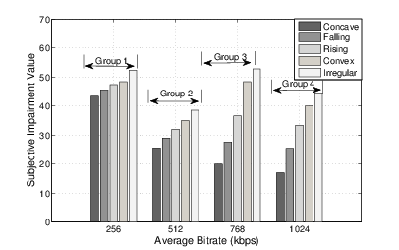
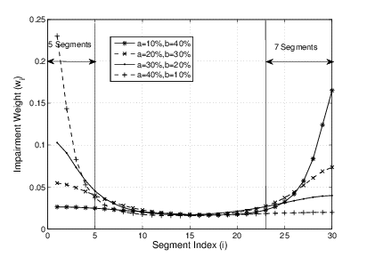
QoE Model for Level Variation
Subjective impairment tests under simulated environment
Influence factors:
Average bitrate
Bitrate fluctuation patterns:
Concave, Falling, Convex
Irregular: bitrate switches frequently with huge amplitude
Bitrate switching frequency
Impairment on bitrate fluctuation pattern
Based on Primacy and Recency Effects
Impairment on bitrate switching
Notes:
Irregular: bitrate switches frequently with huge amplitude
QoE dash属于1-5
35 test videos from both simulated environment and real network traces
PCC= 0.92, RMSE = 0.14

Slide 8
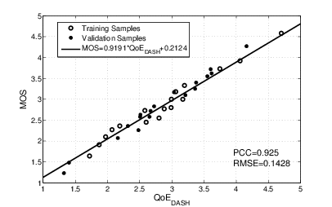
QoE Model for Level Variation
QoE evaluation functions:
Performance analysis
35 test videos from both simulated environment and real network traces
Two-fold cross validation
PCC= 0.92
RMSE = 0.14
Our QoE model can reflect user’s experience on DASH accurately
Notes:
Irregular: bitrate switches frequently with huge amplitude
QoE dash属于1-5
35 test videos from both simulated environment and real network traces
PCC= 0.92, RMSE = 0.14

Slide 9
QoE Model for Level Variation
Influence factors from the subjective test:
Average bitrate
Bitrate switching frequency
Bitrate fluctuation patterns: Concave, Falling, Convex, Irregular
Impairment on bitrate fluctuation pattern I_{BFP}
Based on Primacy and Recency Effects
Evaluation functions of BFP in the posters
Impairment on bitrate switching I_{SW}
Frequency downward bitrate switching causes serious subjective impairment
QoE evaluation functions:
Notes:
Irregular: bitrate switches frequently with huge amplitude
QoE dash属于1-5
35 test videos from both simulated environment and real network traces
PCC= 0.92, RMSE = 0.14

Slide 10
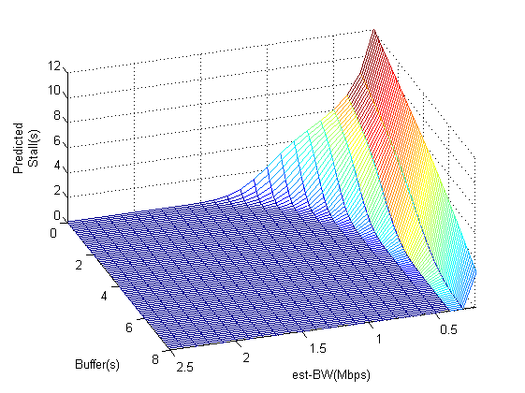

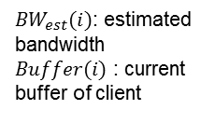

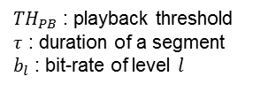
Stall Prediction of DASH Service
Segment size (bytes) obeys Gaussian Distribution ^{[1]}
Stall probability
Stall duration
Apply (5) into Ref.[2] to get the QoE impairment prediction of Stall
Stall occurs when the unequal (2) fits, i.e. When $S_{l}(i)≥S_{d}$, a stall will happen.
(1)
${TH}_{PB}$ : playback threshold
$τ$ : duration of a segment
$b_{l}$ : bit-rate of level $l$
${BW}_{est}(i)$: estimated bandwidth
$Buffer(i)$ : current buffer of client
(2)
(3)
(4)
(5)
(6)
[1] Dmitri Jarnikov et al, "Client intelligence for adaptive streaming solutions “, 2011
[2] Yao Liu et al,” User Experience Modeling for DASH Video” ,2013
Predicted stall duration:
$τ$=2s, $b_{l}$=2Mbps, ${TH}_{PB}$=8s

Slide 11
QoE Based Bitrate Adaptation in DASH
Performance simulation
*Modify QoE model^{[1]} into real-time form
*Overall Optimization^{[3]} : theoretical upper bound under a given bandwidth variation scenario.
Select bitrate level l_{selected}(i) for requesting segment i, according to:
QoS_{Net}(i) : network condition;
S(i): DASH client state(buffer length.etc);
KPI_{DASH}(i-1): previous KPIs of DASH( stall, initial delay, level variation etc.).
Orient to maximize use experience
[1] Yao Liu et al,” User Experience Modeling for DASH Video” ,2013.
[2] Dongeun Suh et al, "QoE-enhanced Adaptation Algorithm over DASH for Multimedia Streaming" 2014.
[3] Dmitri Jarnikov et al, "Client intelligence for adaptive streaming solutions “, 2011.

Slide 12
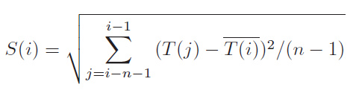

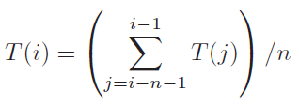


Bandwidth Estimation in DASH
Step1: Variation pattern detection
CV(i): Coefficient Variation of last n segments' throughput
S(i): Standard variation of last n segments' throughput
T(i): Average of last n segments' throughput
The small value of CV (i) reflects a slight fluctuation of throughput or outliers within a short term;
The big value reflects a persistent large variation of available bandwidth.
Step2: Bandwidth computation

Slide 13
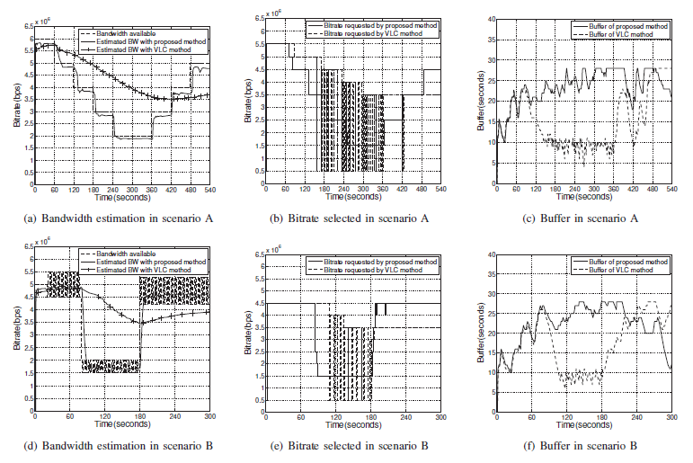
Bandwidth Estimation in DASH
2 typical scenarios(compare our method with VLC method)
Bandwidth estimation with our method
Long-term variation within a wide range – Response quickly
Short-term fluctuation within a narrow range – Keep stable
Bitrate selection with our method
– Appropriate switch without frequent fluctations
Buffer with our method
– Adequate buffer length

Slide 14
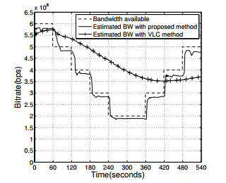
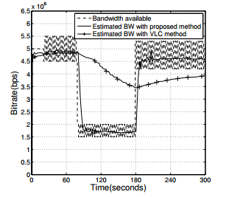

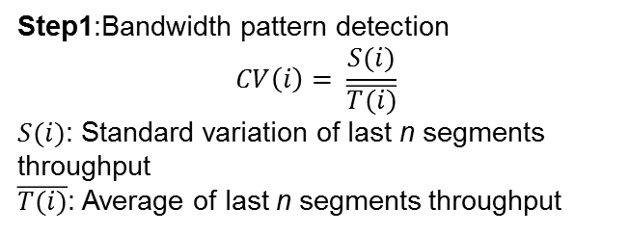
Bandwidth Estimation in DASH
2 typical scenarios
Long-term variation within a wide range – Response quickly
Short-term fluctuation within a narrow range – Keep stable
Step1:Bandwidth pattern detection
$$CV\left(i\right)= \frac{S(i)}{\overline{T(i)}}$$
$S(i)$: Standard variation of last n segments throughput
$\overline{T(i)}$: Average of last n segments throughput
Step 2: Bandwidth computation
$${BW}_{e}\left(i\right)= \sum_{j=i−n−1}^{i−1}{p\left(j−\left(i−n−1\right)\right)T(j)}$$
$p\left(k\right)= \left\{\begin{aligned}\frac{e^{k}}{\sum_{i=0}^{n−1}{e^{i}}} if CV\left(i\right)>0.1 \\ \frac{1}{n} others\end{aligned}\right.$

Slide 15
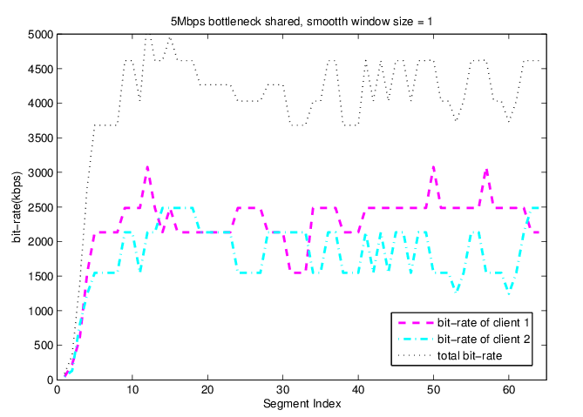
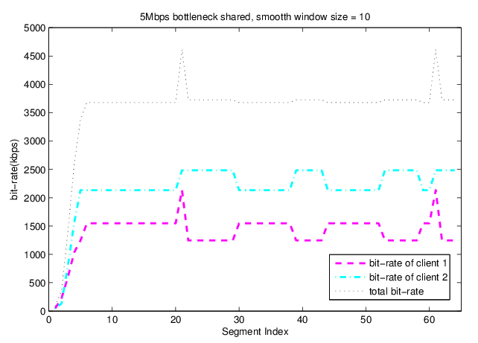
Multi-Users in DASH service (on going)
More practical scenario: multi-users in DASH service environment
Analyze different bitrate adaptation algorithms
When bitrate adaptation is smoother, fairness and efficiency are less suffers.
Further work:
Improve fairness and efficiency / Trade off between QoE and fairness
Users=2 , smooth window size = 1
Users=2 , smooth window size = 10
Unfairness = 545.9, Utilization = 0.819
Unfairness = 784.3, Utilization = 0.712
Smooth window size: The number of segments which is involved in bandwidth estimation.
9

Slide 16
Thank You

